Slide 1
Emergency Badge
2nd Charleville Lone Girl Guides

Slide 2
Our Girl Guide Promise
I promise that I will do my best
To be true to myself and develop my beliefs
To serve my community and Australia
And live by the Guide Law

Slide 3
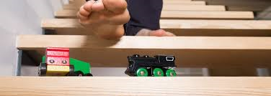
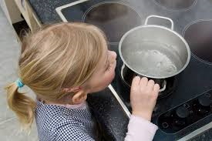
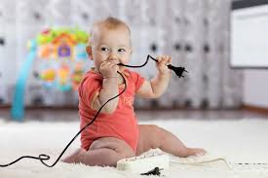
What Accidents Can Happen?
Notes:
Use the annotation tool to have girls write on the screen or just discuss. Guides will give lots of stories of what accidents they have been in or seen.

Slide 4
Notes:
Use the annotation tool to have girls write on the screen or just discuss who are the emergency services and adults they can call

Slide 5
First Aid Treatments: What will you teach us next time?
Severe Bleeding
A Nosebleed
A Burn
Snakebite
An Unconscious Person
Clothing on Fire
Sunburn
A Small Cut or Graze
As a patrol, pick a topic and prepare for next week

Slide 6
Reflection: what was the most fun today?

